Slide 1
Time series Forecasting
Prediction of Sales

Slide 2
Insights of Given data
1. we are creating a time series data according to dates in months, every data point is repeating after 14 values.
2. we sorted the data according to date to be in a proper format for analysis.
3. there was an extra data point of 17th January 2018, which has to be removed
4.we have to predict 36 data points for sales

Slide 3
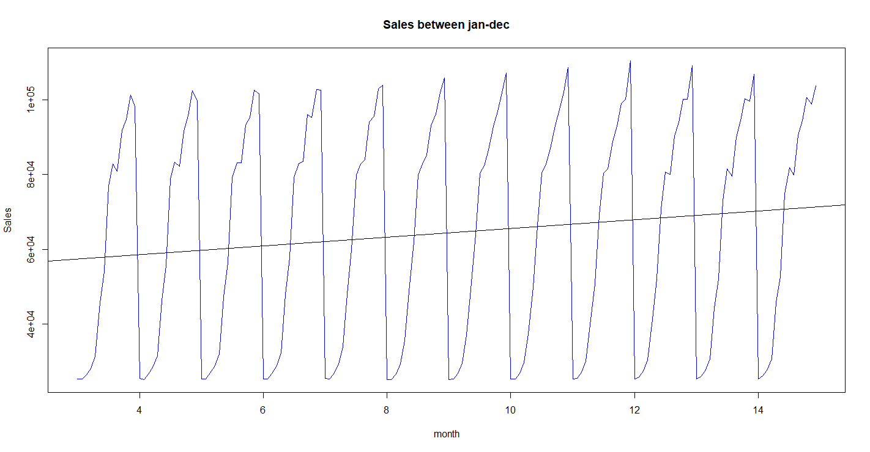
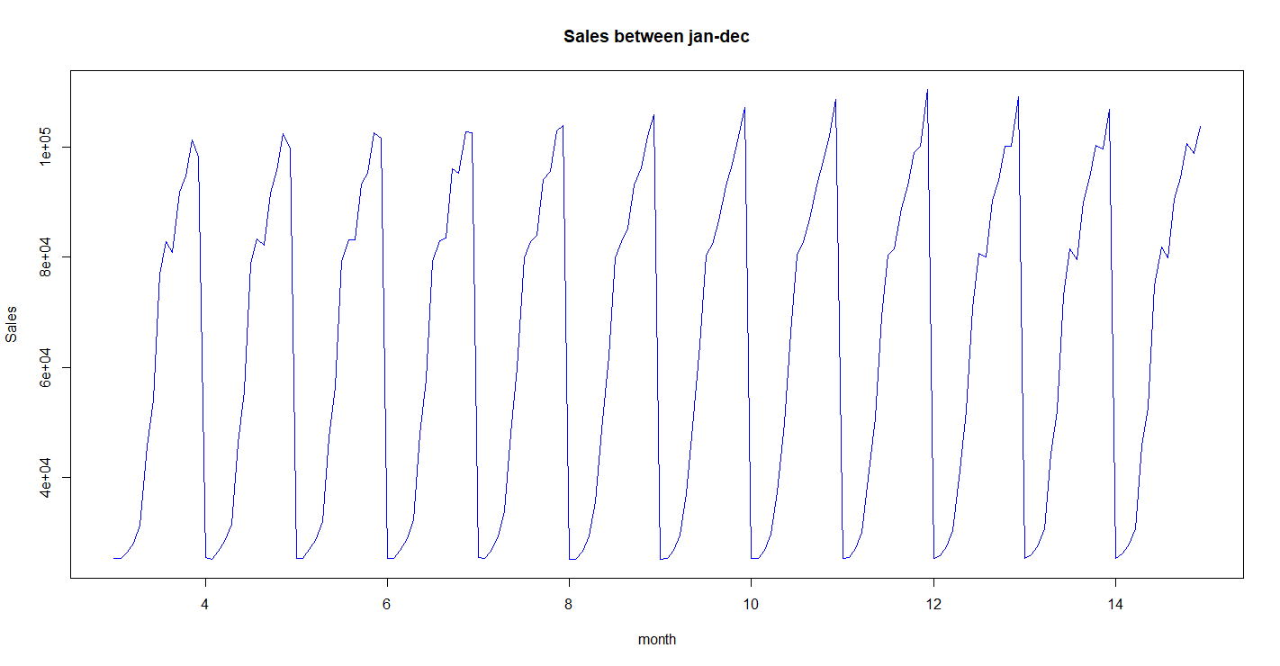
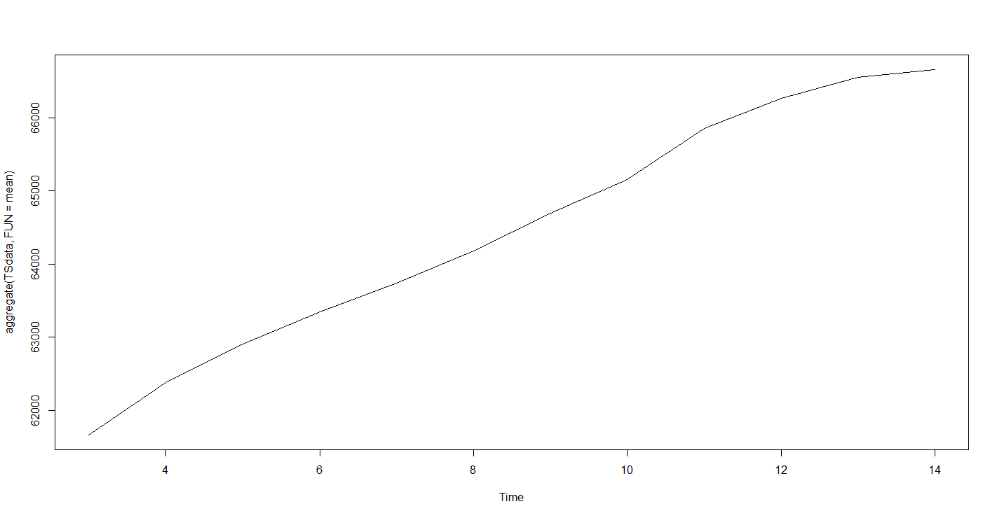
Regression line
Data plot
For 3rd to 16th of each month
from January to December 2018
Trend line

Slide 4
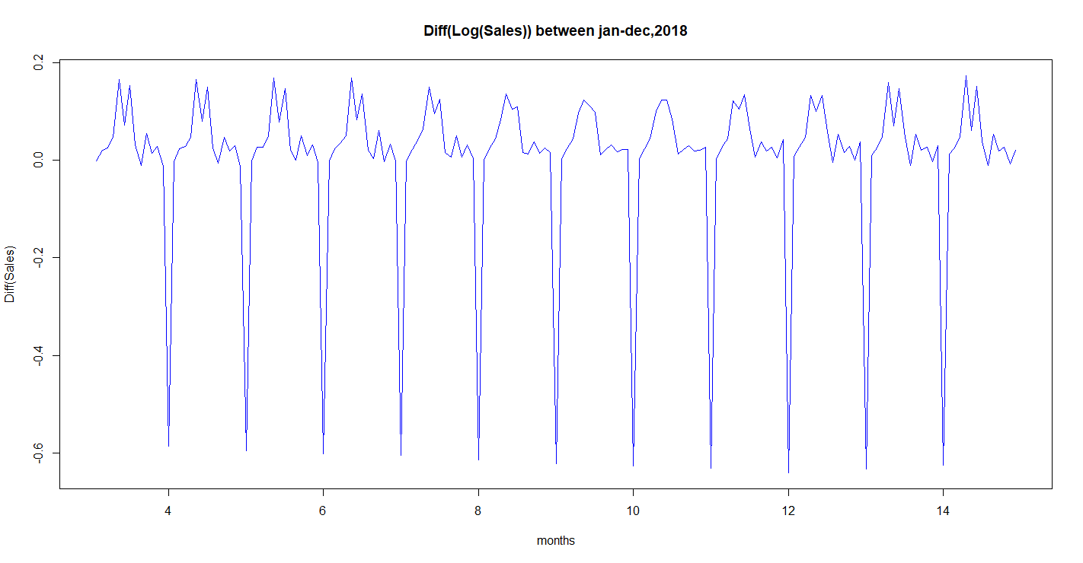
Differencing and Log transformation the data to remove trend and unequal variance
So, with Log10 and 1 order of differencing makes the series stationary

Slide 5
Augmented Dickey-Fuller Test data:
Dickey-Fuller = -6.957,
Lag order = 5,
p-value = 0.01
alternative hypothesis: stationary
KPSS Test for Level Stationarity data:
KPSS Level = 0.014382,
Truncation lag parameter = 2,
p-value = 0.1
p-value greater than printed p-value

Slide 6
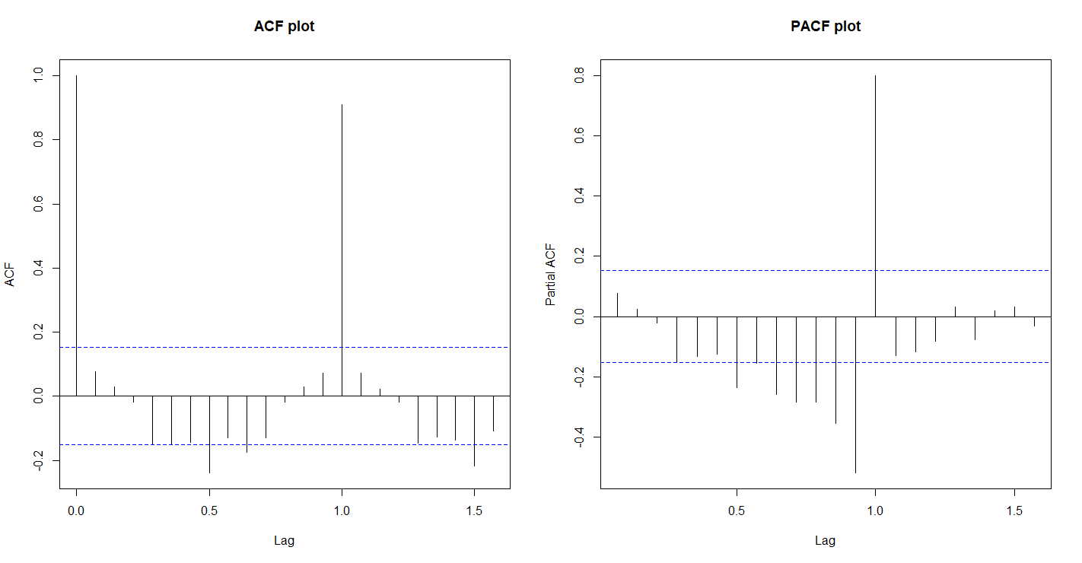
P = 1 (pacf plot significant spike)
D= 1 diffrencing taken
Q= 0 (ACF plot significant spike)

Slide 7
summary(ARIMAFit)
Call: arima(x = (log10(TSdata)),
order = c(1, 1, 0))
Coefficients: ar1 0.0772 s.e. 0.0769 sigma^2 estimated as 0.02915: log likelihood = 58.24, aic = -112.48
Training set error measures:
ME RMSE MAE MPE MAPE MASE ACF1
0.003391408 0.1702156 0.08574579 0.009835556 1.87613 0.9971184 -0.0017485
summary(ARIMAFit1) Series: log10(TSdata) ARIMA(0,0,0)(1,1,0)[14] Coefficients: sar1 0.7027 s.e. 0.0532 sigma^2 estimated as 2.723e-05: log likelihood=592.63 AIC=-1181.26 AICc=-1181.18 BIC=-1175.18 Training set error measures: ME RMSE MAE MPE MAPE MASE ACF1 0.001359451 0.004979434 0.003547776 0.02904195 0.07456525 0.7210562 0.02908752
Here we have lower MAPE in Auto.ARIMA method (ARIMAFit1), so we use it for our predictions

Slide 8
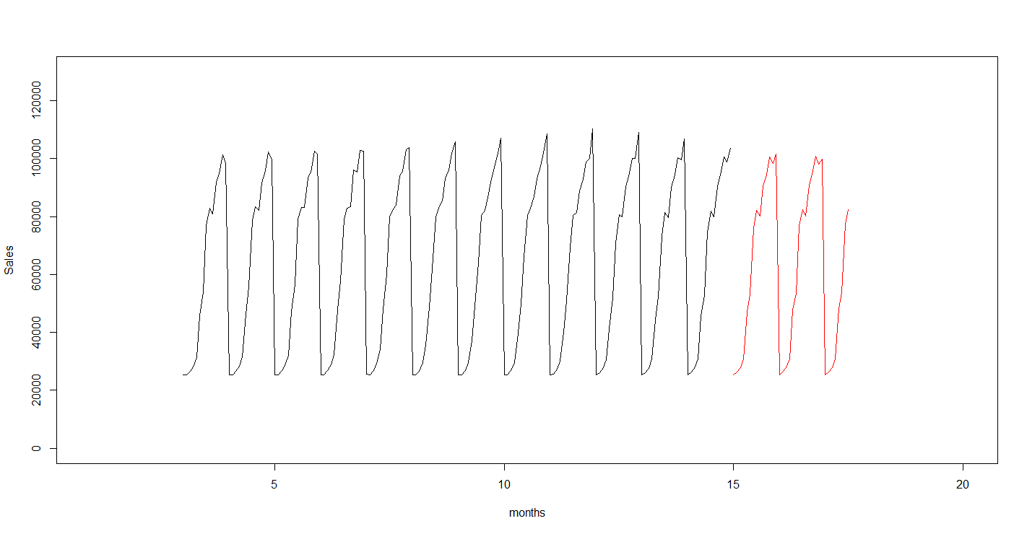
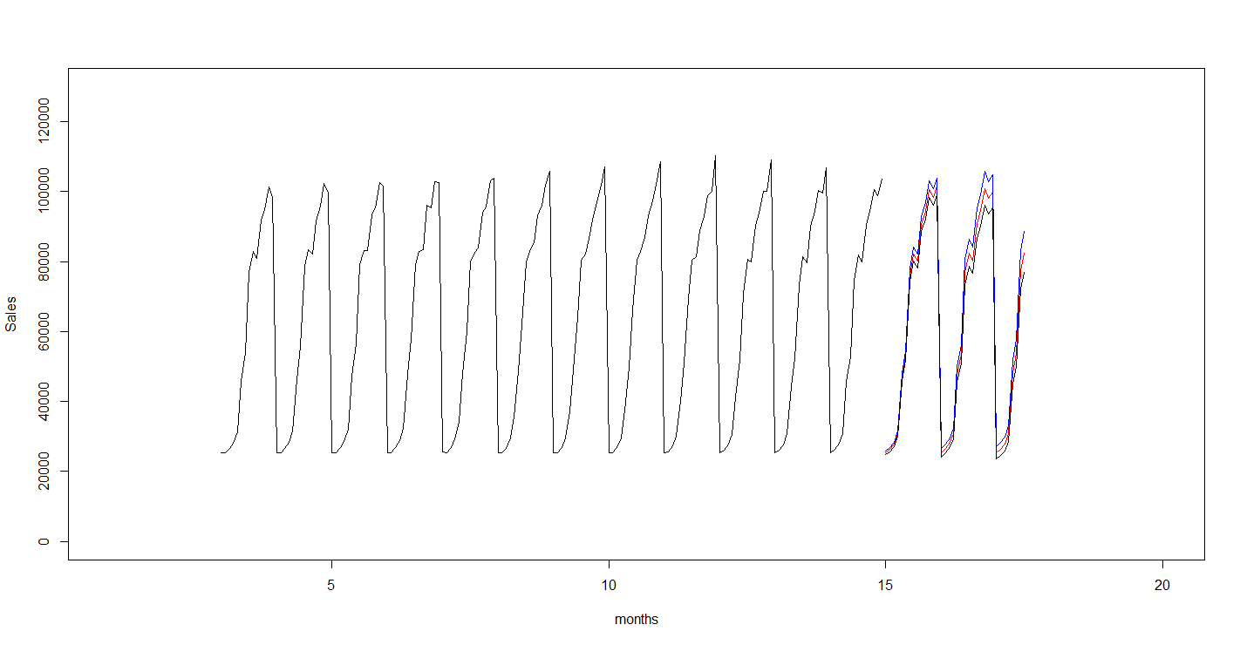
Final prediction plot of sales
for 36 more months
Final Predictions
Red Plot = Prediction
Blue plot = prediction if there is positive varience.
Black plot= prediction if there is negetive varience.

Slide 9
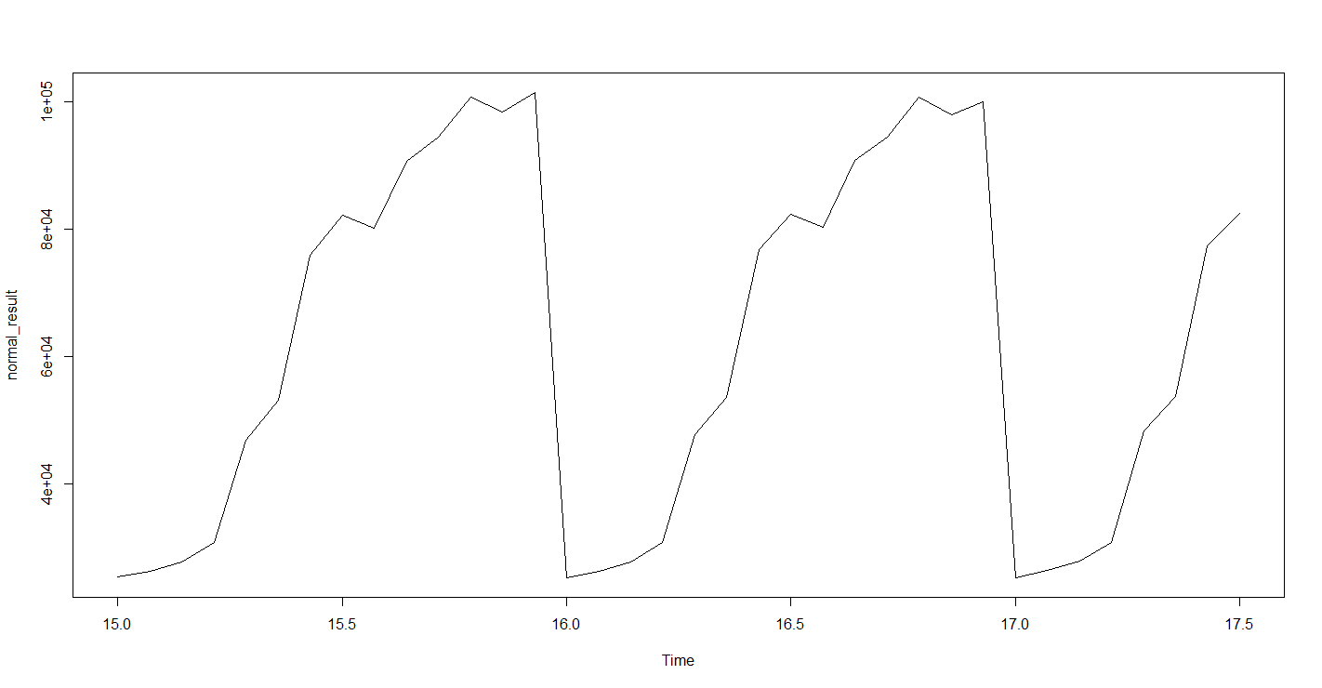
Result Plot
For 36 data points ahead of given data

Slide 10
Thank You

